Slide 1
Development Across the Lifespan
Chapter 7

Slide 2
Chapter 7 Learning Objective Menu
LO 7.1 Special research methods used to study development
LO 7.2 Relationship between heredity and environmental factors
LO 7.3 Chromosomes, genes and DNA
LO 7.4 How twins develop during pregnancy
LO 7.5 How conjoined twins adjust to being connected
LO 7.6 Germinal, embryonic, and fetal periods of pregnancy
LO 7.7 Physical changes in infancy and childhood
LO 7.8 Facts and myths concerning infant immunizations
LO 7.9 Three ways of looking at cognitive development
LO 7.10 How language develops
LO 7.11 How infants and children develop personalities and form relationships
LO 7.12 Erikson’s first four stages of psychosocial development
LO 7.13 Changes in puberty
LO 7.14 How adolescents develop formal operation and moral thinking
LO 7.15 Adolescent’s search for identity
LO 7.16 Physical and cognitive changes during adulthood and aging
LO 7.17 Work, relationships, parenting, aging, and death
LO 7.18 Theories of why aging occurs
LO 7.19 Stages of death and dying
LO 7.20 How attention-deficit/hyperactivity disorder affects adults

Slide 3
Developmental Research Designs
LO 7.1 Special research methods used to study development
Human development - the scientific study of the changes that occur in people as they age from conception until death.
Longitudinal design - research design in which one participant or group of participants is studied over a long period of time.
Cross-sectional design - research design in which several different age groups of participants are studied at one particular point in time.
Cross-sequential design - research design in which participants are first studied by means of a crosssectional design but also followed and assessed for a period of no more than six years.
Menu

Slide 4
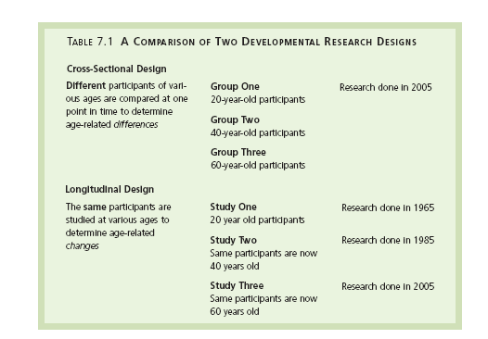
LO 7.1 Special research methods used to study development
Menu

Slide 5
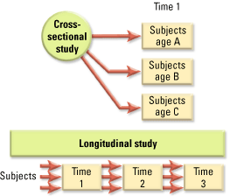
LO 7.1 Special research methods used to study development
Menu

Slide 6


Longitudinal Design
Tested at 1 year
(Time 1)
Again at 4 years
(Time 2)
Again at 7 years
(Time 3)

Slide 7
Longitudinal Design
Compare
Compare
Tested at 1 year
(Time 1)
Again at 4 years
(Time 2)
Again at 7 years
(Time 3)
Same Participants
Different Times
Different Times
Different Times

Slide 8
Cross-Sectional Design
Same Time
Compare
Compare
1-year-olds
4-year-olds
7-year-olds
Same Time
Different Participants
Different Participants
Different Participants

Slide 9
Nature versus Nurture
LO 7.2 Relationship between heredity and environmental factors
Nature - the influence of our inherited characteristics on our personality, physical growth, intellectual growth, and social interactions.
Nurture - the influence of the environment on personality, physical growth, intellectual growth, and social interactions.
Behavioral genetics – focuses on nature vs. nurture.
Menu

Slide 10
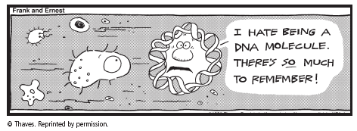
Genetics and Development
LO 7.3 Chromosomes, genes and DNA
Genetics - the science of inherited traits.
DNA (deoxyribonucleic acid) - special molecule that contains the genetic material of the organism.
Gene - section of DNA having the same arrangement of chemical elements.
  Dominant - referring to a gene that actively controls the expression of a trait.
  Recessive - referring to a gene that only influences the expression of a trait when paired with an identical gene.
Menu

Slide 11
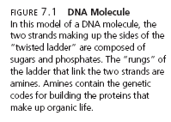
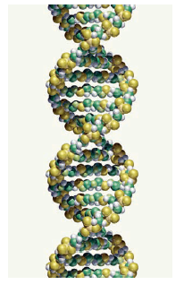
LO 7.
Menu

Slide 12

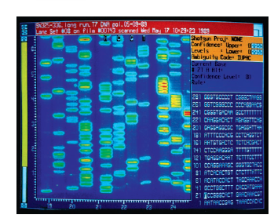
LO 7.3 Chromosomes, genes and DNA
Menu

Slide 13
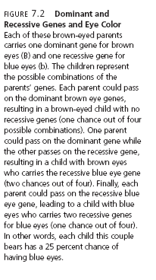
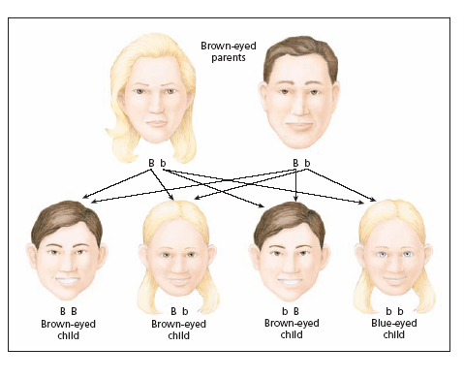
LO 7.3 Chromosomes, genes and DNA
Menu

Slide 14
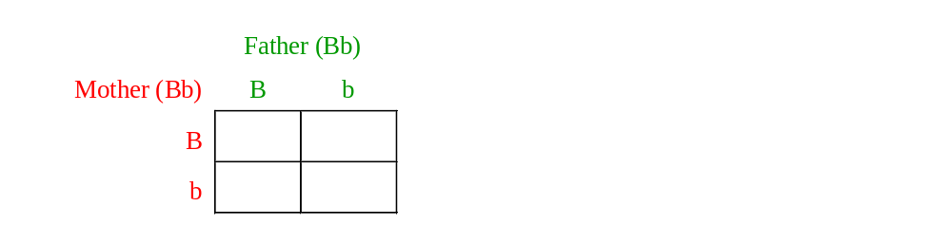
Mendel Box
B=Brown eyes b=Blue eyes
LO 7.3 Chromosomes, genes and DNA
Menu

Slide 15

Mendel Box
B=Brown eyes b=Blue eyes
LO 7.3 Chromosomes, genes and DNA
Menu

Slide 16
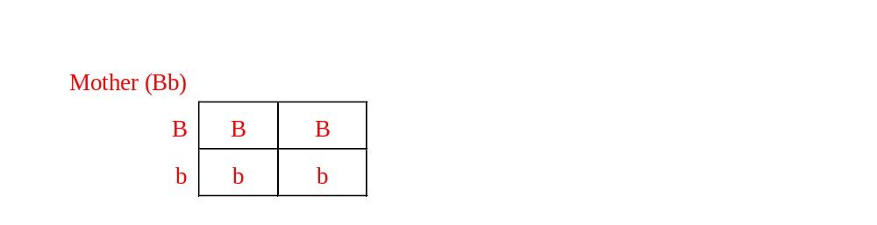
Mendel Box
B=Brown eyes b=Blue eyes
LO 7.3 Chromosomes, genes and DNA
Menu

Slide 17
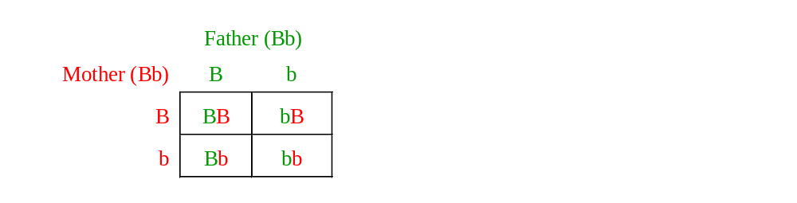
Mendel Box
B=Brown eyes b=Blue eyes
LO 7.3 Chromosomes, genes and DNA
Menu

Slide 18

75% have brown eyes.
25% have blue eyes.
)
LO 7.3 Chromosomes, genes and DNA
Menu

Slide 19
Genetics and Development
LO 7.3 Chromosomes, genes and DNA
Chromosome - tightly wound strand of genetic material or DNA.
Chromosome disorders include Down syndrome, Klinefelter’s syndrome, and Turner’s syndrome, whereas genetic disorders include PKU, cystic fibrosis, sickle cell anemia, and Tay-Sachs disease.
Menu

Slide 20
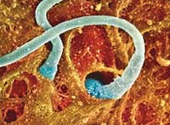
Genetics and Development
LO 7.3 Chromosomes, genes and DNA
Conception - the moment at which a female becomes pregnant.
Ovum - the female sex cell, or egg.
Fertilization - the union of the ovum and sperm.
Zygote - cell resulting from the uniting of the ovum and sperm; divides into many cells, eventually forming the baby.
Menu

Slide 21
Conception and Twins
LO 7.4 How twins develop during pregancy
Monozygotic twins - identical twins formed when one zygote splits into two separate masses of cells, each of which develops into a separate embryo.
Dizygotic twins - often called fraternal twins, occurring when two eggs each get fertilized by two different sperm, resulting in two zygotes in the uterus at the same time.
Menu

Slide 22
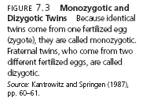
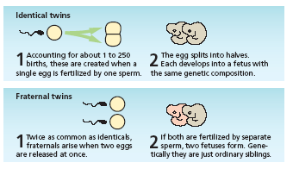
LO 7.4 How twins develop during pregancy
Menu

Slide 23
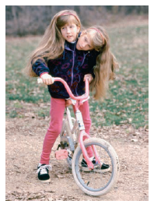
Conjoined Twins
LO 7.5 How conjoined twins adjust to being connected
Conjoined twins Abby and Britty Hensel are relatively healthy, well adjusted, and participate fully in many normal activities for young people of their age.
Menu

Slide 24
Periods of Pregnancy
LO 7.6 Germinal, embryonic, and fetal periods of pregnancy
Germinal period - first two weeks after fertilization, during which the zygote moves down to the uterus and begins to implant in the lining embryo name for the developing organism from two weeks to eight weeks after fertilization.
Embryonic period - the period from two to eight weeks after fertilization, during which the major organs and structures of the organism develop.
  Critical periods - times during which certain environmental influences can have an impact on the development of the infant.
  Teratogen - any factor that can cause a birth defect.
Menu

Slide 25
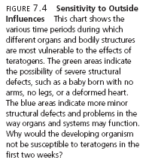
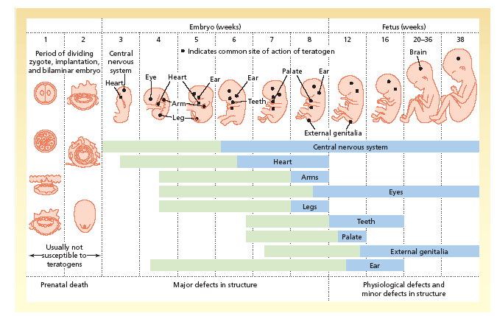
LO 7.6 Germinal, embryonic, and fetal periods of pregnancy
Menu

Slide 26
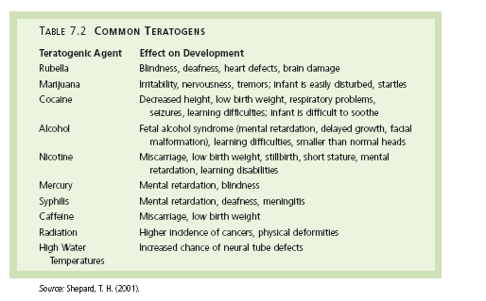
LO 7.6 Germinal, embryonic, and fetal periods of pregnancy
Menu

Slide 27
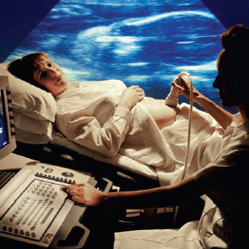
Periods of Pregnancy
LO 7.6 Germinal, embryonic, and fetal periods of pregnancy
Fetal period - the time from about eight weeks after conception until the birth of the child.
  Fetus - name for the developing organism from eight weeks after fertilization to the birth of the baby.
Menu

Slide 28

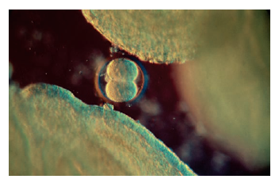
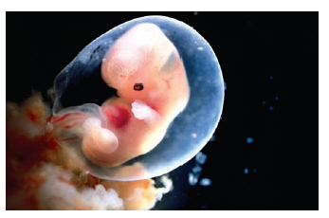
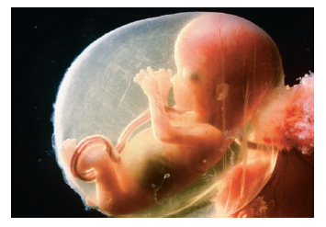
LO 7.6 Germinal, embryonic, and fetal periods of pregnancy
Menu

Slide 29
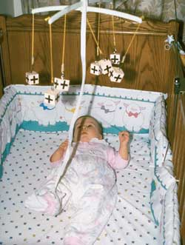
Physical Development in Infancy and Childhood
LO 7.7 Physical changes in infancy and childhood
Four critical areas of adjustment for the newborn are:
  Respiration
  Digestion
  Circulation
  Temperature regulation
Infants are born with reflexes that help the infant survive: sucking, rooting, Moro (startle), grasping, and Babinski.
The senses, except for vision, are fairly well developed at birth.
Gross and fine motor skills develop at a fast pace during infancy and early childhood.
Menu

Slide 30
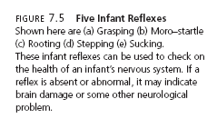
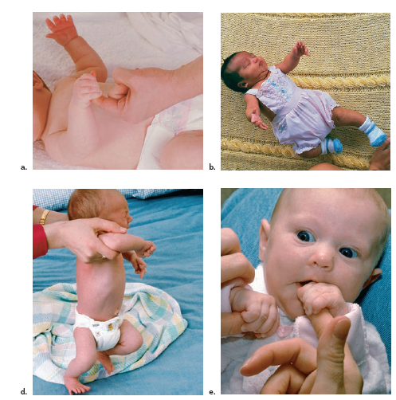
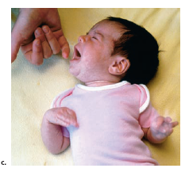
LO 7.7 Physical changes in infancy and childhood
Menu

Slide 31

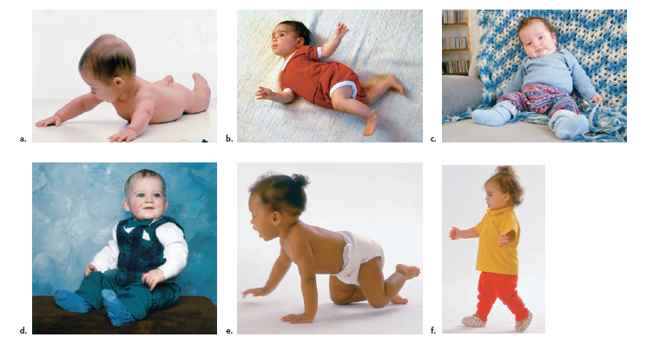
LO 7.7 Physical changes in infancy and childhood
Menu

Slide 32
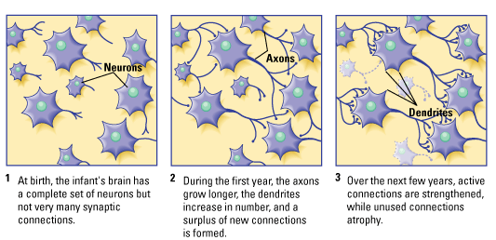
LO 7.7 Physical changes in infancy and childhood
Menu

Slide 33
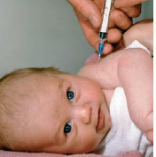
Immunizations
LO 7.8 Facts and myths concerning infant immunizations
Immunizations are far less dangerous than the diseases they are designed to prevent and are one of the most effective weapons in the fight against infectious diseases.
Menu

Slide 34
Cognitive Development
LO 7.9 Three ways of looking at cognitive development
Cognitive development - the development of thinking, problem solving, and memory scheme (plural schemas) a mental concept formed through experiences with objects and events.
Menu

Slide 35
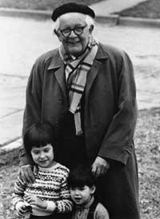
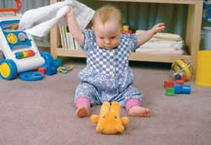
Piaget’s Stage Theory
LO 7.9 Three ways of looking at cognitive development
Sensorimotor stage - Piaget’s first stage of cognitive development in which the infant uses its senses and motor abilities to interact with objects in the environment.
  Object permanence - the knowledge that an object exists even when it is not in sight.
Menu

Slide 36
Piaget’s Stage Theory
LO 7.9 Three ways of looking at cognitive development
Preoperational stage - Piaget’s second stage of cognitive development in which the preschool child learns to use language as a means of exploring the world.
  Egocentrism - the inability to see the world through anyone else’s eyes.
  Centration - in Piaget’s theory, the tendency of a young child to focus only on one feature of an object while ignoring other relevant features.
  Conservation - in Piaget’s theory, the ability to understand that simply changing the appearance of an object does not change the object’s nature.
  Irreversibility - in Piaget’s theory, the inability of the young child to mentally reverse an action.
Menu

Slide 37
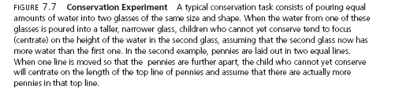
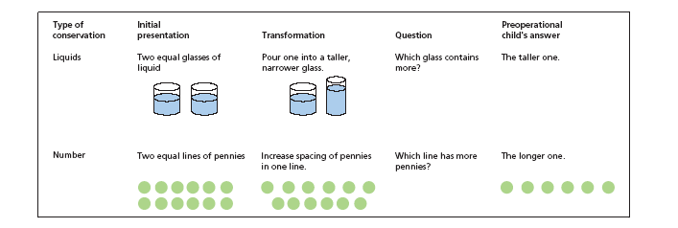
LO 7.9 Three ways of looking at cognitive development
Menu

Slide 38
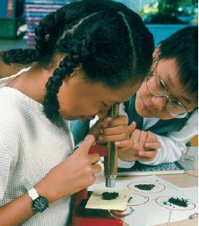
Piaget’s Stage Theory
LO 7.9 Three ways of looking at cognitive development
Concrete operations stage - third stage of cognitive development in which the school-age child becomes capable of logical thought processes but is not yet capable of abstract thinking.
Formal operations - Piaget’s last stage of cognitive development in which the adolescent becomes capable of abstract thinking.
Menu

Slide 39
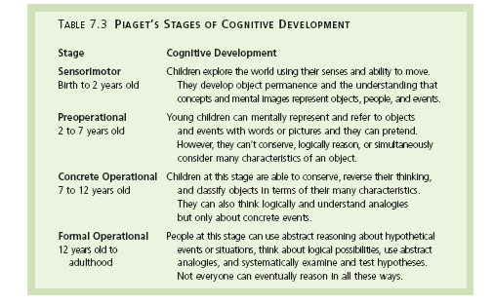
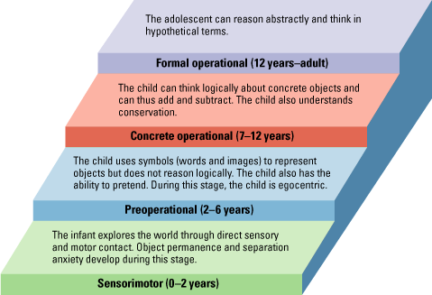
LO 7.9 Three ways of looking at cognitive development
Menu

Slide 40
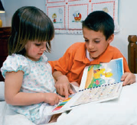
Vygotsky’s Theory
LO 7.9 Three ways of looking at cognitive development
Scaffolding - process in which a more skilled learner gives help to a less skilled learner, reducing the amount of help as the less skilled learner becomes more capable.
Zone of proximal development (ZPD) - Vygotsky’s concept of the difference between what a child can do alone and what that child can do with the help of a teacher.
Menu

Slide 41
Information Processing Theory
LO 7.9 Three ways of looking at cognitive development
Metamemory – process by which children improve in their memory capacity as they age, learn to use control strategies to improve memory performance, and gain a better understanding of how their own memories work.
Menu

Slide 42

Stages of Language Development
LO 7.10 How language develops
Cooing
Babbling
One-word speech (holophrases)
Telegraphic speech
Language acquisition device - governs the learning of language during infancy and early childhood.
Menu

Slide 43
Temperament
LO 7.11 How infants and children develop personalities / form relationships
Temperament - the behavioral characteristics that are fairly well established at birth.
  Easy - regular, adaptable, and happy
  Difficult - irregular, nonadaptable, and irritable
  Slow to warm up - need to adjust gradually to change.
Menu

Slide 44
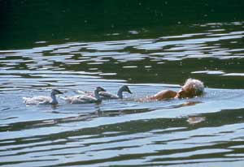
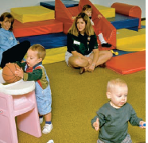
Attachment
LO 7.11 How infants and children develop personalities / form relationships
Attachment - the emotional bond between an infant and the primary caregiver.
  Secure - willing to explore, upset when mother departs but easily soothed upon her return.
  Avoidant – unattached; explore without “touching base.”
  Ambivalent - insecurely attached; upset when mother leaves and then angry with mother upon her return.
  Disorganized-disoriented – insecurely attached and sometimes abused or neglected; seemed fearful, dazed, and depressed.
Menu

Slide 45
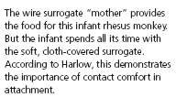
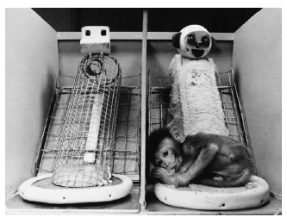
LO 7.11 How infants and children develop personalities / form relationships
Menu

Slide 46
Erikson’s First Four Stages
LO 7.12 Erikson’s first four stages of psychosocial development
Trust versus mistrust - first stage of personality development in which the infant’s basic sense of trust or mistrust develops as a result of consistent or inconsistent care.
Autonomy versus shame and doubt - second stage of personality development in which the toddler strives for physical independence.
Menu

Slide 47
Erikson’s First Four Stages
LO 7.12 Erikson’s first four stages of psychosocial development
Initiative versus guilt - third stage of personality development in which the preschool-aged child strives for emotional and psychological independence and attemps to satisfy curiosity about the world.
Industry versus inferiority - fourth stage of personality development in which the adolescent strives for a sense of competence and self-esteem.
Menu

Slide 48
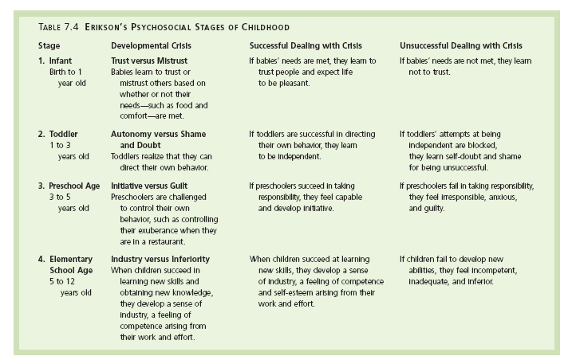
LO 7.12 Erikson’s first four stages of psychosocial development
Menu

Slide 49
Gender Role Development
LO 7.12 Erikson’s first four stages of psychosocial development
Gender- the behavior associated with being male or female.
Gender identity - perception of one’s gender and the behavior that is associated with that gender.
Menu

Slide 50
Puberty and Adolescence
LO 7.13 Changes in puberty
Adolescence - the period of life from about age 13 to the early twenties, during which a young person is no longer physically a child but is not yet an independent, self-supporting adult.
Puberty - the physical changes that occur in the body as sexual development reaches its peak.
  Period of about four years.
Menu

Slide 51
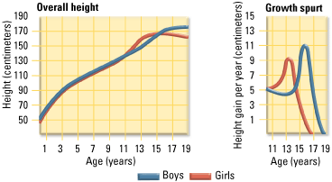
LO 7.13 Changes in puberty
Menu

Slide 52
Egocentric Thinking
LO 7.14 How adolescents develop formal operation and moral thinking
Personal fable - type of thought common to adolescents in which young people believe themselves to be unique and protected from harm.
Imaginary audience - type of thought common to adolescents in which young people believe that other people are just as concerned about the adolescent’s thoughts and characteristics as they themselves are.
Menu

Slide 53
Development of Morality
LO 7.14 How adolescents develop formal operation and moral thinking
Preconventional morality - first level of Kohlberg’s stages of moral development in which the child’s behavior is governed by the consequences of the behavior.
Conventional morality - second level of Kohlberg’s stages of moral development in which the child’s behavior is governed by conforming to the society’s norms of behavior.
Postconventional morality - third level of Kohlberg’s stages of moral development in which the person’s behavior is governed by moral principles that have been decided on by the individual and which may be in disagreement with accepted social norms.
Menu

Slide 54

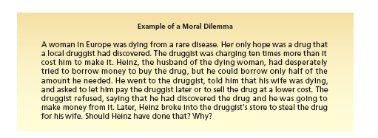
LO 7.14 How adolescents develop formal operation and moral thinking
Menu

Slide 55
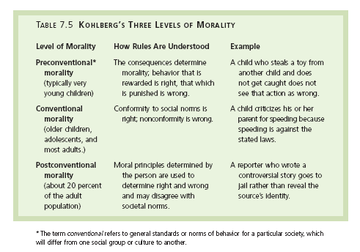
LO 7.14 How adolescents develop formal operation and moral thinking
Menu

Slide 56
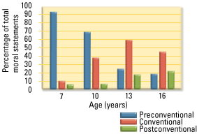
LO 7.14 How adolescents develop formal operation and moral thinking
Menu

Slide 57
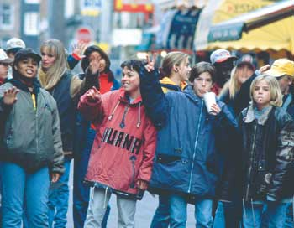
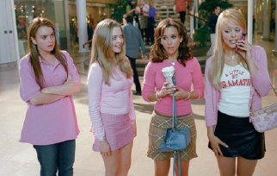
Erikson’s Fifth Stage
LO 7.15 Adolescent’s search for identity
Identity versus role confusion - fifth stage of personality development in which the adolescent must find a consistent sense of self.
Menu

Slide 58

Physical Changes and Aging
LO 7.16 Physical and cognitive changes during adulthood and aging
Adulthood begins in the early twenties and ends with death in old age.
  Divided into young adulthood, middle adulthood, and late adulthood.
Women experience a physical decline in the reproductive system called the climacteric, ending at about age 50 with menopause - the cessation of ovulation and menstrual cycles and the end of a woman’s reproductive capability.
Andropause - gradual changes in the sexual hormones and reproductive system of males.
Increase in health problems, decrease in reaction time, and stability in intelligence and memory.
Menu

Slide 59
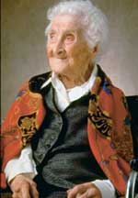
LO 7.16 Physical and cognitive changes during adulthood and aging
Jeanne Calment of Arles, France, was the oldest living human ever recorded. Biologists see 120 as the upper limit of the human life span. In February 1997, six months before her death, Calment celebrated her 122nd birthday.
Menu

Slide 60
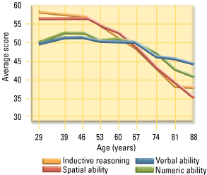
LO 7.16 Physical and cognitive changes during adulthood and aging
Menu

Slide 61

LO 7.16 Physical and cognitive changes during adulthood and aging
Menu

Slide 62

LO 7.16 Physical and cognitive changes during adulthood and aging
Menu

Slide 63
Erikson’s Last Three Stages
LO 7.17 Work, relationships, parenting, aging, and death
Intimacy - an emotional and psychological closeness that is based on the ability to trust, share, and care, while still maintaining a sense of self.
Generativity - providing guidance to one’s children or the next generation, or contributing to the well-being of the next generation through career or volunteer work.
Integrity - sense of wholeness that comes from having lived a full life and the ability to let go of regrets; the final completion of the ego.
Menu

Slide 64

LO 7.17 Work, relationships, parenting, aging, and death
Menu

Slide 65

Theories of Aging
LO 7.18 Theories of why aging occurs
Activity theory - theory of adjustment to aging that assumes older people are happier if they remain active in some way, such as volunteering or developing a hobby.
Cellular clock theory - based on the idea that cells only have so many times that they can reproduce; once that limit is reached, damaged cells begin to accumulate.
Menu

Slide 66
Theories of Aging
LO 7.18 Theories of why aging occurs
Wear-and-tear theory - as time goes by, repeated use and abuse of the body’s tissues cause it to be unable to repair all the damage.
Free radical theory - oxygen molecules with an unstable electron move around the cell, damaging cell structures as they go.
Menu

Slide 67

Stages of Death and Dying
LO 7.19 Stages of death and dying
Denial
Anger
Bargaining
Depression
Acceptance
Menu

Slide 68

Adult ADHD
LO 7.20 How attention-deficit/hyperactivity disorder affects adults
Many children with ADHD grow up to be adults with ADHD, affecting their work, relationships, and emotional well-being.
ADHD in adults can be treated with medication and/or therapy.
Menu

